Slide 1
Sensation and Perception
Chapter 6

Slide 2
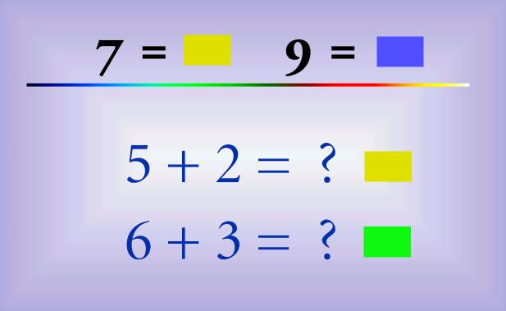

Slide 3
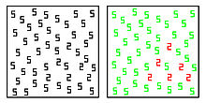

Slide 4
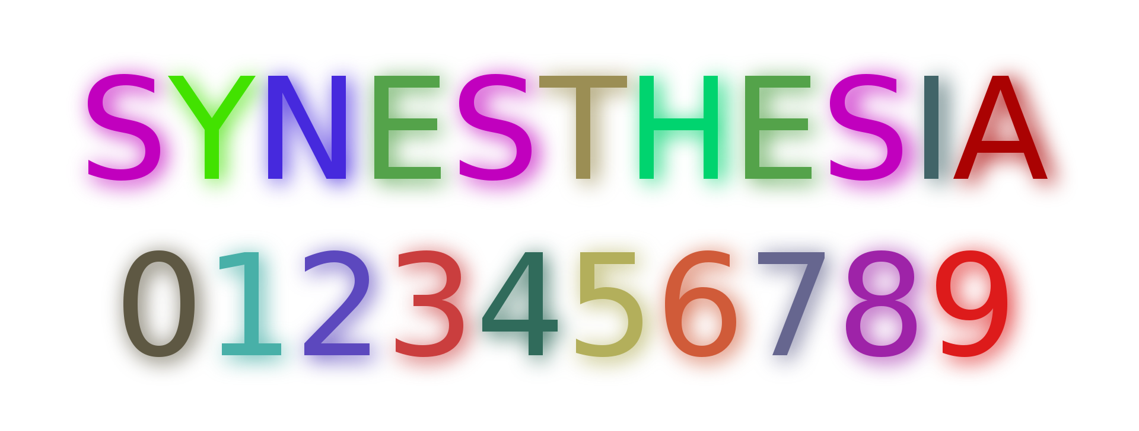

Slide 5
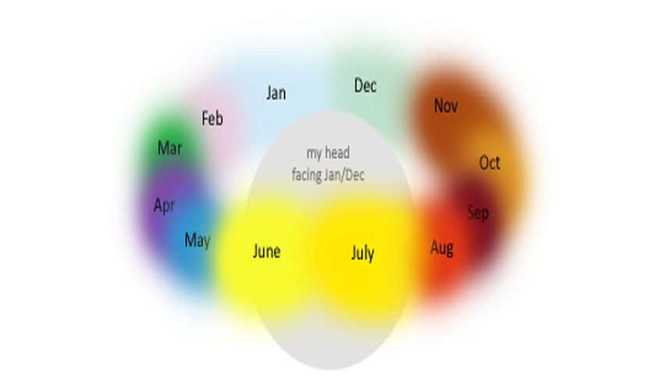

Slide 6
Synesthesia
A condition in which one sense is simultaneously perceived by one or more additional senses
Synesthetes may perceive peoples names with another sensory perception such as smell, taste or color

Slide 7
Our Sensational Senses
6.1

Slide 8
5 Basic Senses
Vision (eyes)
Hearing (ears)
Taste (tongue)
Touch (skin)
Smell (nose)

Slide 9
Sensations
Sense receptors (inside organs) sense STIMULUS
Turns the energy of the stimulus into electrical impulses
Impulses are transmitted to the NERVOUS SYSTEM
The nervous system decides what to do with the stimulus

Slide 10
The Riddle of Separate Sensations
Doctrine of Specific Nerve Energies:
Claims we have different nerve paths for each sense
Signals from eyes travel along the OPTIC NERVES
Signals from ears travel along the AUDITORY NERVES
“If sound could stimulate EYES, we could essentially see sound”

Slide 11
Absolute Thresholds
MINIMAL amount of STIMULUS needed for us to notice it
Normal Senses:
See candle 30 miles away on a dark night (optimal conditions)
Hear a ticking watch 20 feet away
Taste a tsp of sugar diluted in 2 gallons of water

Slide 12
Lacking Senses
We can NOT see radio or microwave waves
Dogs and cats can detect HIGH FREQUENCY sounds that we can not
“Doggie Whistle” or cats hearing mice
Bees can SEE ultraviolet light which ONLY sunburns humans

Slide 13
Difference Threshold
Smallest difference in STIMULATION that a person can detect
EX. Weight of 2 blocks
Brightness of 2 lights
Saltiness of 2 liquids

Slide 16
Sensory Adaptation
The more frequently we sense a STIMULI the less our bodies respond
Spares us from having to respond to USELESS information
Ex. You can’t feel the watch sitting on your wrist
We will NOT adapt to extreme sensations (pain) (heat) (smell of ammonia)

Slide 17
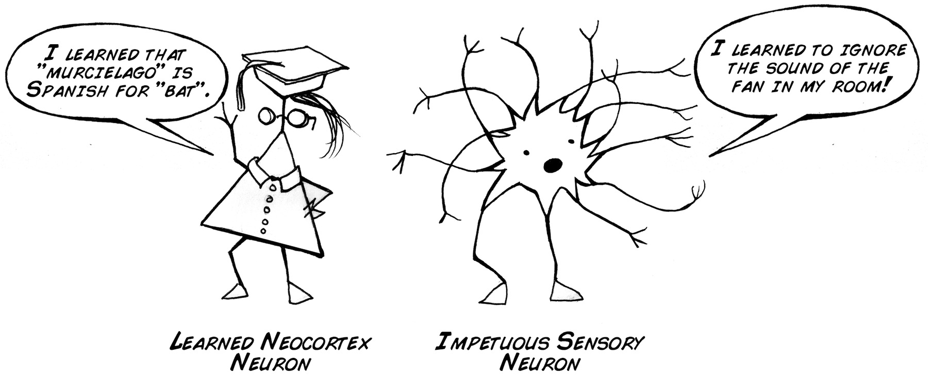
Copyright: Backyard Brains

Slide 18
Sensory Deprivation (2 Studies)
Forced
Unforced
Had to stay in for certain amount of time
Anxiety
Hallucinations
Confused
Edgy
Had a PANIC a button / could be released whenever
Relaxing
Intellectual gain
Enjoyable

Slide 19
Section 1 Review:
1. Where do signals from the EYES travel along? The EARS?
2. Describe ABSOLUTE THRESHOLD. Give an example.
3. Give an example of something your senses will NOT adapt to.
4. Would you find a sensory DEPRIVATION chamber relaxing or problematic? Explain.

Slide 20
Vision
6.2

Slide 21
Color
1. Hue: Variation in color (based on wavelengths)
Think of a RAINBOW
2 Brightness: Intensity of LIGHT an object emits or reflects
More light = brighter
3. Saturation: COLORFULNESS (variation of ONE color)
Think of light green to forest green

Slide 22
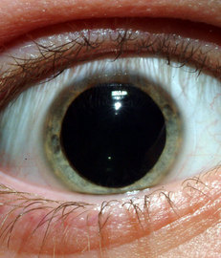
Dark Adaptation
It takes time for our eyes to adjust to dim light
RODS and CONES are visual receptors that respond to dim light and color
Within 10 minutes eyes begin to adjust (cones)
Within 20 minutes vision will get as good as is possible (rods)

Slide 23
Color Deficiency
Retina has cones that respond to BLUE, GREEN and RED
All colors are made up of a combination of the 3
Total COLOR BLINDNESS is due to a malfunction when all 3 do not work (world is black and grey)
EXTREMELY rare in human beings
Color DEFICIENT is lacking one of the 3 (much more common in men than women)

Slide 24
Gestalt Principles
Proximity
Closure
Things NEAR each other tend to be grouped together
**** **** ****
(3 patterns of stars)
Brain will fill in gaps of NON COMPLETE figures

Slide 25
Gestalt Principles
Similarity
Continuity
Things that are ALIKE tend to be perceived as belonging together
Lines and patterns tend to continue in space

Slide 26
Depth and Distance Perception (chart p.191)
Binocular Cues (using 2 eyes)
Monocular Cues
They CONVERGE when you focus on a nearby image (50ft or less)
Receive slightly different images of the same object
(hold finger close to nose and open and close one eye at a time)
Cues that do NOT depend on use of both eyes
Further than 50ft

Slide 27
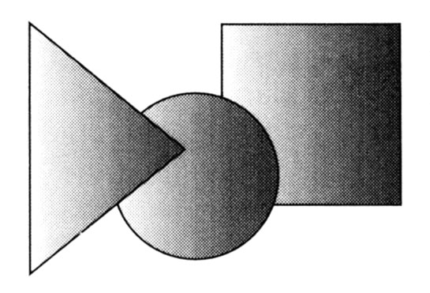
Interposition
One object blocks another in distance we know it to be closer

Slide 28
Linear Perspective
Parallel lines will appear to converge in the distance
The greater the convergence, the greater the perceived distance

Slide 29
Section 2 Review:
1. Compare HUE to SATURATION.
2. How are color BLINDNESS and color DEFICIENCY different?
3. How does CLOSURE of an image work?
4. When are MONOCULUAR CUES used and give one example from the txt. P.190-191.

Slide 30
Hearing
6.3

Slide 31
Loudness
INTENSITY of a soundwaves pressure
Measured in DECIBELS (dB)
Absolute threshold for humans is 0 dB
Ex. Refrigerator is 50 Db; shop tools 90 dB

Slide 32
Damage
Continued exposure to sounds over 85 dB WILL cause hearing loss
The greater the dB the less exposure need
85dB 8 hours
110 1 minute 29 seconds
Above 140 ANY exposure

Slide 33
Pitch
FREQUENCY of the soundwave (High or low)
How rapidly the air vibrates per second
Measured in Hertz (Hz)
Absolute Threshold in humans 16 Hz
Lower Hz = lower pitch (organ)

Slide 34
Timbre
Quality of sound
PURE TONE = 1 frequency (extremely rare)
When many frequencies are present we hear NOISE
When ALL frequencies of the spectrum are present we hear WHITE NOISE

Slide 35
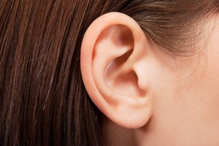
Outer Ear
Soft funnel shaped tissue
Collect sound waves
Not needed for hearing
Hearing would be GOOD (not great) without it

Slide 36
Middle Ear
Ear drums
Can pick up a SINGLE molecule of movement (sound)
Passes the signal along through 3 tiny bones (smallest in the human body) to the INNER EAR
Hammer / Anvil / Stirrup

Slide 37
Inner Ear
Organ responsible for HEARING
Plays the same role as the RETINA does in seeing
Contains small receptors called HAIR CELLS
Sustained exposure to loud noises can permanently damage the cells
Will cause HEARING LOSS

Slide 38
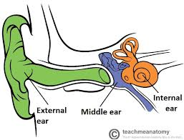

Slide 39
The Auditory World
We use LOUDNESS as a cue to sense distance of a sound
Many Animals can move ears independently to sense sounds from different directions
Humans can’t so we must turn our head to a side to pick up direction of noise
Hard for humans to pick up direction of sound

Slide 40
Section 3 Review:
1. Describe LOUDNESS. What is it measure in?
2. What is PITCH measure in? What is the ABSOLUTE THRESHOLD humans can hear?
3. What is the purpose of the OUTER EAR?
4. Where does HEARING actually occur?

Slide 41
Other Senses
6.4

Slide 42
Taste (4 basic- 5 total)
Salty: Necessary for bodily functions
Sour: Detect poison
Bitter: Detect rancid food (past date)
Sweet: Healthful / rich in calories (survival)
Delicious (MSG additive) NOT a basic taste

Slide 43
How It Works
Taste receptors are located primarily on the TONGUE
Tongue has tiny bumps called PAPILLAE that contain TASTE BUDS
Human taste buds range from 500-10k
Replaced every 10 days until age 40; it declines after that

Slide 44
Attractiveness
Different in each culture
Ex. Japan loves octopus; America loves beef
Affected by color, temperature and texture
Ex. Soup is better hot, ketchup is weird when it was purple / oysters are slimy

Slide 45
What Were They Thinking?

Slide 46
Smell (Biology)
Millions of receptor located in the NASAL PASSAGE just beneath your eyes
You inhale and bring air into your nose and throat and respond to chemicals in the air
Message is transmitted to the brain
10k or more smells humans can identify / dogs 400k

Slide 47
Smell cont.
Less important for humans than other animals for survival
Still important for smelling smoke, poison gases, rotten food
Infection, disease and smoking will eliminate smell receptors

Slide 48
Skin Senses (4)
Protects our internal organs from the outside world
Touch (pressure / texture), warmth, cold , pain
Within these 4 contain: itch, tickle and painful burning
Some areas of skin are more responsive to certain senses
We know the least about how TOUCH works

Slide 49
Section 4 Review:
1. List the 4 BASIC tastes and what each is meant to do.
2. Where are the TASTE RECEPTORS primarily located? How often are they replaced.
3. Where are millions of SMELL receptors located?
4. Which SENSE do we know the least about?

